Slide 1
Topic 6: Semiconductor memories
Memory

Slide 2
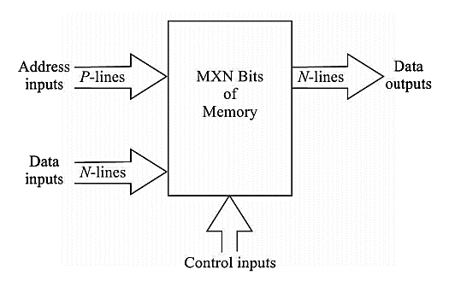
Memory
The basic elements of a semiconductor memory is a flip flop in which the information is stored in binary form.
The size of a memory chip is determined by MxN bits, where M is the no. of locations available in the memory and N refers to no. of bits in each location.
Each of the M locations in the memory is defined by a unique address and for accessing an address requires P address lines where M=2^P. This address line activates a certain location of the memory and then read or write operation is done.

Slide 3
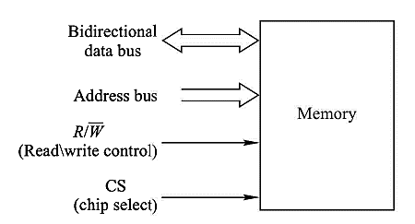
Memory
More general block diagram of a computer memory
Blocks

Slide 4
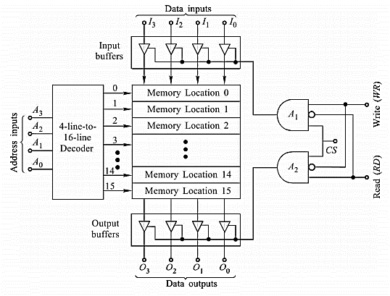
Memory
Block diagram of a 16x4 computer memory

Slide 5


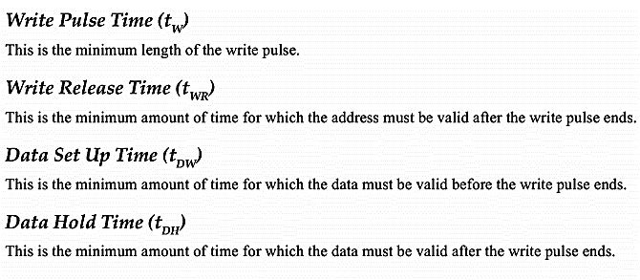
Write operation
Sequence of activities:

Slide 6
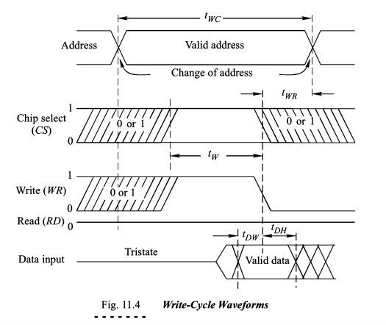

Write operation

Slide 7

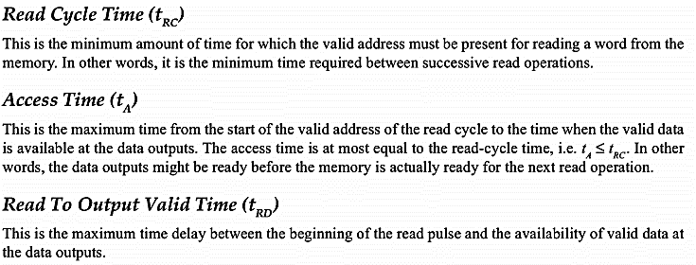
Read operation
Sequence of activities:

Slide 8
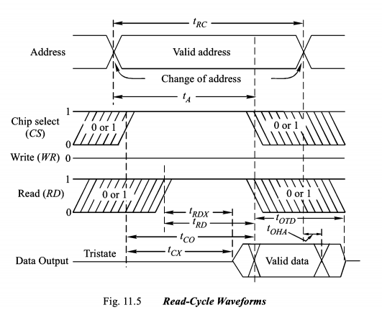
Read operation

Slide 9
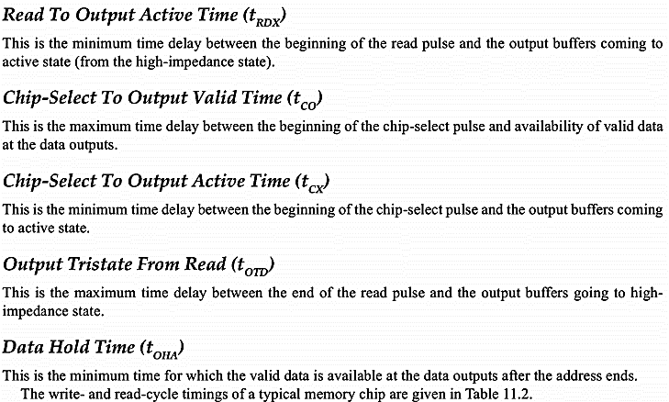
Read operation

Slide 10
Different memory devices
Many kinds of storage devices may be used for memory elements.
The old types of memories such as magnetic cores, electromechanical relays are rarely used in today’s computer.
Today’s storage or memory devices can be categorized into
Semiconductor memories - ROMs and RAMs (or write-and-read memory)
Magnetic storage - disks (random access) and tapes (serial access)
Optical storage (or disk) - disks (random access) including magneto-optical disk

Slide 11
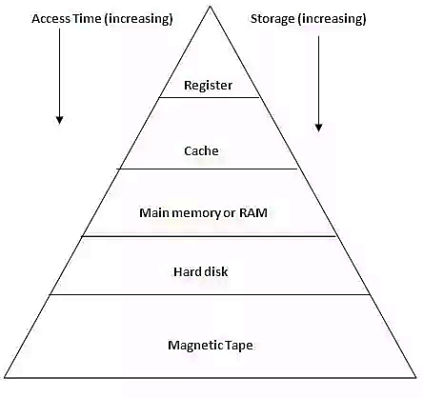
ROM (read-only memory) and RAM (random access memory)
ROM and RAM can be subcategorized into smaller categories.
All ROM is nonvolatile memory device, mostly read but sometimes write memory or flash ROM memory.
All RAM is volatile memory device, which is mostly further subcategorized into SRAM and DRAM.
The term “volatile” describes a memory that loses its stored data when the dc power is removed.
Traditional (read-and-write) memory hierarchy in computer:
Groups of flip-flops
SRAM
DRAM
Semiconductor
Memory

Slide 12

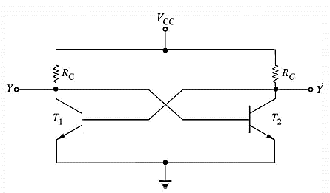
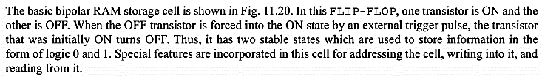
RAM

Slide 13
Static RAM (SRAM)
Static RAMs use flip-flops as storage elements and can therefore store data indefinitely as long as dc power is applied.
A SRAM flip-flop storage cell consists of two cross-connected NMOS at the drain (this cross-connected configuration is specific for a latch).
Each NMOS consists of two N-channel MOSFETs.
The load MOSFET (active load) is always in the ON state and essentially act as load resistors . Q5 and Q6 serve as voltage-controlled switches (transmission gates) that permit reading or writing into the cell.
V_{DD}
N-MOS
D
SRAM CELL
G
Q1 Load MOSFET
Bit Select
S
V_{OUT}
G
D
+ V_{DD}
Q2 switching MOSFET
V_{IN} +
-
S
Q1
Q2
Data
Data
Q5
Q6
V_{IN} Q1 Q2 V_{OUT} = V’_{IN}
0V R_{ON} = R_{OFF} = V_{DD}
(logic 0) 100kΩ 10G Ω (logic 1)
5V R_{ON} = R_{ON} = +0.05v
(logic 1) 100kΩ 1kΩ (logic 0)
Q3
Q4

Slide 14
Static RAM (SRAM) cont.
The SRAM cell can be compared with the SR latch. The Bit Select input is equivalent to the Enable or Clock input. The Data and Data’ inputs/outputs are equivalent to S and R inputs as well as also Q and Q’ outputs of SR latch. Hence, the input data and output data can share the same lines because write and read operations occur at different times.
Bit Select
+ V_{DD}
Q1
Q2
Data
Data
Q5
Q6
Q3
Q4
Operation: Assume we want to store (write) 1 into the cell. Data should be 1 (Data’ = 0).
When the Bit Select is high, Q5 and Q6 are turned on. Q3 will be stored 1, which then turns on Q4 through the cross-connection from Q3 drain to the Q4 gate. At the same time, Q4 will be stored 0 and by the same manner, it turns off the Q3 by the cross-connection.
After the Bit Select is low, the states of the Q3 and Q4 are maintained due to the cross-connections, i.e. in this case, the Q3 drain voltage holds the Q4 at on and the Q4 drain voltage holds the Q3 at off.

Slide 15
Dynamic RAM (DRAM)
Dynamic RAMs use capacitors as storage elements and cannot retain data very long without the capacitors being recharged by a process called refreshing.
Refreshing requires additional memory circuitry and complicates the operation of the DRAM.
A DRAM cell consists of a single MOSFET and a capacitor.
The MOSFET is a transmission gate.
The basic operation of a DRAM cell is illustrated in the right figure below and is as follow (see table). The arrows show refreshing a stored 1 (top arrow) and storing 1 (bottom arrow).
Refresh buffer
Bit Select
Bit Select
Refresh
refreshing
D_{OUT}
Data
R/W
1
D_{IN}
Output buffer/
Sense amplifier
Storing 1
Input buffer

Slide 16
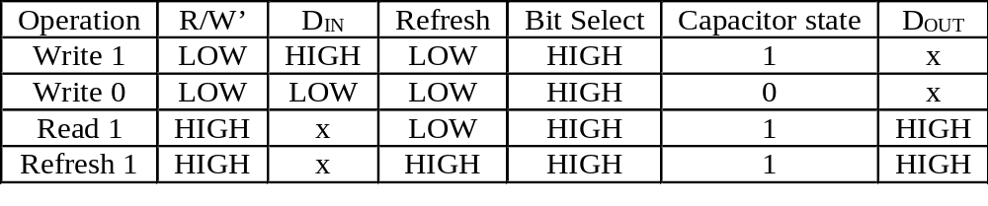
Dynamic RAM (DRAM) cont.
R/W’ is the enable input to control the tristate output buffer and the tristate input buffer; In this case, a LOW will enable the input buffer and disable the output buffer. (Buffer is a gate follower, which can drive large amount of gates and tristate buffer is a buffer with an Enable control input.)
The transmission gate is on when the Bit Select is High.
Capacitor state: 1 means the capacitor has been charged to a positive voltage and 0 means the capacitor is uncharged.
Refresh buffer
Bit Select
Refresh
refreshing
D_{OUT}
R/W
1
D_{IN}
Output buffer/
Sense amplifier
Storing 1
Input buffer

Slide 17
DRAM and SRAM advantages and disadvantages
Data can be read much faster from SRAMs than from DRAMs.
DRAMs can store much more data than SRAMs for a given physical size and cost because the DRAM cell is much simpler, and more cells can be crammed into a given area than in the SRAM.
Both SRAM and DRAM can be asynchronous and synchronous types.

Slide 18
Read-only Memory
A ROM contains permanently or semipermanently stored data, which can be read from the memory but either cannot be changed at all or cannot be changed without specialized equipment.
A ROM store data that are used repeatedly in system applications, such as tables, conversions, or programmed instructions for system initialization and operation. ROMs retain stored data when the power is off and are therefore nonvolatile memories.

Slide 19
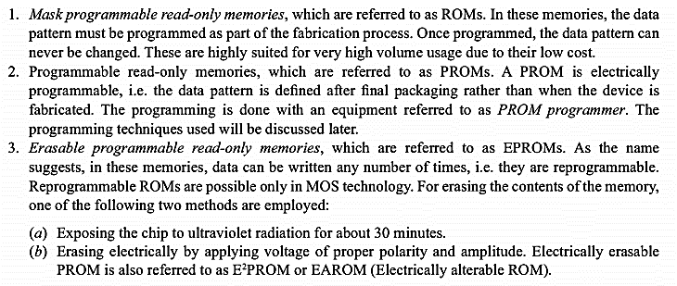
Read-only Memory
Based on programmability, the ROM can be categorized as:

Slide 20
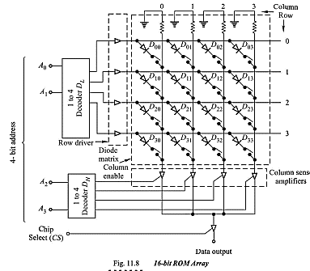
Read-only Memory
Example of a 4x4=16 bit ROM:

Slide 21
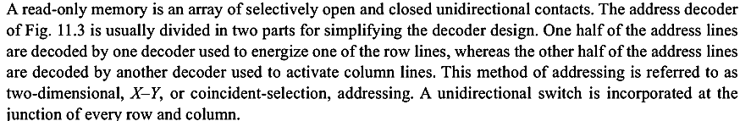

Read-only Memory
Operation of a 4x4=16 bit ROM:

Slide 22
Mask ROM
The mask ROM is usually referred to simply as a ROM.
It is permanently programmed during the manufacturing process to provide widely used standard functions.
Most IC ROMs utilize the present or absence of a transistor connection at a row/column junction to represent a 1 or a 0.
A MOSFET ROM cell:
The present of a connection from a row line to the gate of a transistor represents a 1 at that location. This is because when the row line is taken HIGH, all transistors with a gate connection to the row line turn on and connect the HIGH (1) to the associated column lines.
At row/column junctions where there are no gate connections, the column lines remain LOW (0) when the Row is addressed.
Column Data
Column Data
Row
select
+V_{DD}
+V_{DD}
Cell A
Cell B
Storing a 1
Storing a 0

Slide 23
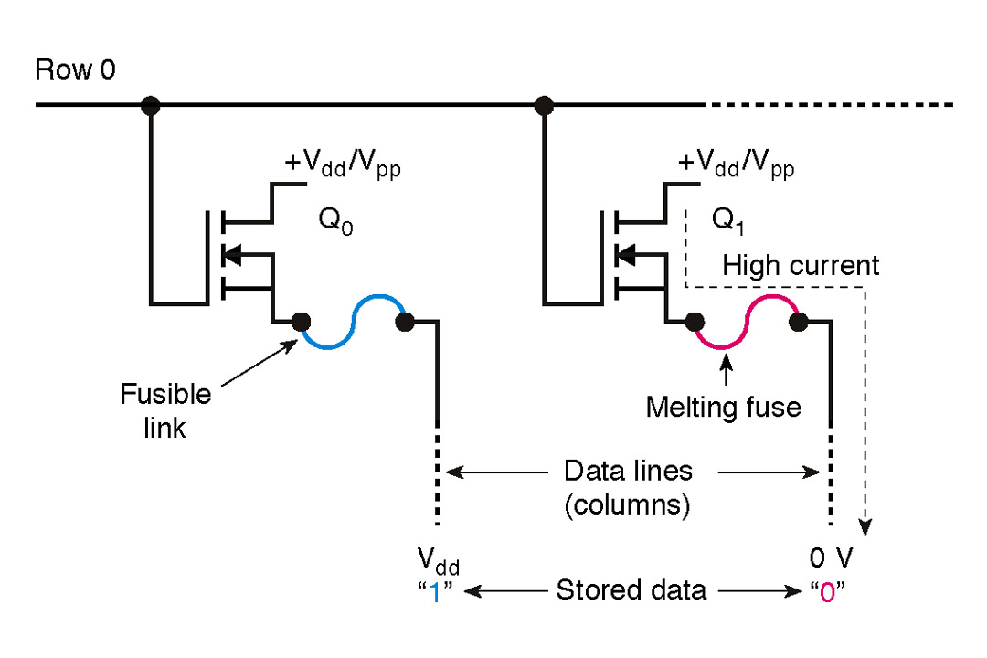
Other types of ROM
The PROM or Programmable ROM is the type which the data are electrically stored by the user with the aid of specialized equipment. Both the Mask ROM and the PROM can be of either MOS or bipolar technology.
The EPROM or erasable PROM is strictly a MOS device. The EPROM is electrically programmable by the user, but the stored data must be erased by exposure to ultraviolet light over a period of several minutes.
The EEPROM or E²PROM, electrically erasable PROM, can be erased in a few milliseconds.

Slide 24
Flash memories
The ideal memory has high storage capacity, nonvolatility, in-system read and write capabilitiy, comparatively fast operation, and cost effectiveness.
The traditional memory technologies such as ROM, PROM, EPROM, EEPROM, SRAM and DRAM individually exhibit one or more of these characteristics, but no single technology has all of them except the flash memory.
Flash memories are high-density read/write memories that are nonvolatile, which means that data can be stored indefinitely without power. They are frequently used in place of floppy or small-capacity hard disk drives in portable computers. It is often called nonvolatile RAM. It has the property to “flash (erase)” a large block of memory.
A storage cell of flash memories consists of a single floating-gate MOS transistor (FGMOS). A data bit is stored as charged or the absence of charge on the floating gate depending if a 0 or a 1 is stored.

Slide 25
Flash memory cell
The amount of charge present on the floating gate determines if the transistor will turn on and conduct current from the drain to the source when a control voltage is applied during a read operation.
Floating
gate
Drain
MOS
transistor
symbol
Control
gate
Source
Few electrons =
less charge = stored 1
Many electrons =
more charge = stored 0
The single-transistor storage cell in a flash memory
There are three major operations in a flash memory: the programming operation, the read operation, and the erase operation.

Slide 26
Basic flash memory operation
Internal field
= small
programming
Reading
Internal field
= finite
Floating
gate
+V_{D}
+V_{D}
+V_{D}
I
+V_{PROG}
+V_{READ}
+V_{READ}
I
Electron is
attracted in
OFF
ON
Reading 0
I = 0
0 V
Reading 1
I = finite
0 V
0 V
Storing 0 operation
The current is sensed; no current indicates a 0
and a current indicates a 1.
Storing 1 operation: no voltage is applied
+V_{D}
Erase
*After programmed, last for 100 years
0 V
Electron is
attracted out
Always erased prior
to being reprogrammed.
+V_{ERASE}

Slide 27
Flash memory cell in array
+V
Active load
(MOS load)
Comparator
When current I = finite, a voltage drop is produced across the active load.
This voltage drop is compared to a reference voltage with a comparator circuit and an output level indicating a 1 is produced.
When current I = 0, no voltage drop is produced. Hence, output is 0.
Bit line m
V_{REF}
Data out m
Row select n
Column
Select m

Slide 28
Memory array in general
Row
Select 0
Row
Select 1
Memory
Cell
Row
Select n
Organized in row and column (n x m)
Only one row is accessed at a time
A group of column line is accessed at a time.
Bit line 0
Bit line 1
Bit line m
Data Input/Output Buffers and Control
Data I/O bus

Slide 29

Any Questions

